Slide 1

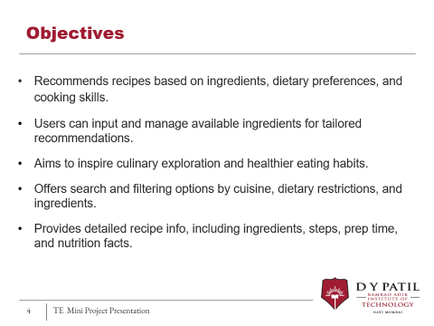
Ramrao Adik Institute of Technology
Department of Computer Engineering
TE MINI Project III Presentation
On
“Feast Fusion”
By
Roll No. Name of Students
21CE1153 Amey Sawant
21CE1171 Khushal Bhalia
21CE1196 Utkarsh Upase
21CE1156 Aditya Raj
Guided by
Pramod H. Kachare

Slide 2

Contents
Introduction
Literature survey of existing systems
Problem statement
Proposed methodology
System design
Hardware & software requirement
References

Slide 3
Introduction
“Feast Fusion" offers personalized recipe recommendations.
Users receive meal ideas tailored to their dietary preferences, available ingredients, and cooking skills.
The platform aims to streamline meal planning, cut food waste, and promote culinary exploration.
Globally, food waste could potentially feed over two billion people, surpassing the number of undernourished individuals.

Slide 4
Objectives
Recommends recipes based on ingredients, dietary preferences, and cooking skills.
Users can input and manage available ingredients for tailored recommendations.
Aims to inspire culinary exploration and healthier eating habits.
Offers search and filtering options by cuisine, dietary restrictions, and ingredients.
Provides detailed recipe info, including ingredients, steps, prep time, and nutrition facts.

Slide 5






Literature Survey
Food Network:-
Established 2017
https://www.foodnetwork.com/
Features:-
Most trusted sources of culinary information
Experienced & talented gourmet experts
Classic & modern food recipes
Limitations:-
Challenging to sort tons of information on web
User complains about irregular site update
Difficult recipes
Yummly:-
Established 2013
https://www.yummly.com/
Features:-
Features outstanding video
Ability to create meal plans based on diet restriction and allergies
User rated recipes
Limitations:-
You need to sign up to share recipes
Filters are only visible once you sign up
More professional recipes

Slide 6

Literature Survey
Edamam :-
Established:2020
https://www.edamam.com/
Features:-
Great filtering features
Identify’ s a recipe ingredients and its nutritional content
Offers link to recipes for cooking instructions
Limitations:-
You need a paid subscription to access premium features
Offers link of recipes rather than recipes itself
Difficult recipes

Slide 7
Problem statement
In today's fast-paced world, people face meal planning challenges and the need to find recipes that match their dietary preferences, ingredients, and culinary skills.
To develop a user-friendly personalized recipe recommendation system.
Using robust recipe recommendation by matching TF-IDF encodings and
Cosine similarity scoring
to empower users in overcoming culinary challenges.

Slide 8
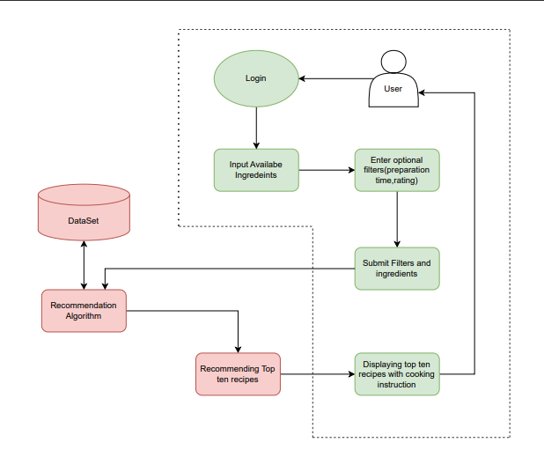
System Design

Slide 9
Proposed Methodology/Techniques
HTML is the standard markup language used to create web pages. It structures content on the web by using a system of elements & tags.
CSS is a stylesheet language used for describing the presentation and formatting of web documents written in HTML.
PHP is a server-side scripting language that is widely used for web development. It is especially well-suited for building dynamic and interactive web applications.
SQL is a domain-specific language used for managing and manipulating relational databases.

Slide 10
Proposed Methodology/Techniques
XAMPP is a popular open-source software package that simplifies the process of setting up a local development environment for web development.
Recipe Dataset:
Dataset for people interested in exploring recipes, nutrition data, & cooking times.
TF-IDF is a measure used in natural language processing to determine the significance of a word in a document compared to a collection of documents.
Flask, a lightweight web framework for Python, is designed to make getting started quick and easy, with the ability to scale up to complex applications.

Slide 11
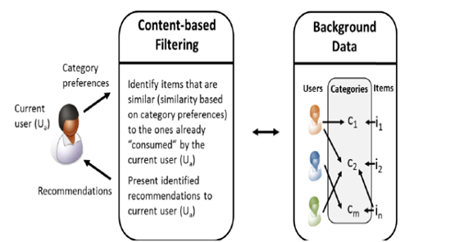

Proposed Methodology/Techniques

Slide 12
Software Requirements
Operating System:- Most modern web browsers are compatible with various operating systems, including Windows, macOS, Linux, iOS, and Android. Users should ensure their operating system is up to date.
Web Browser:- Users should use an up-to-date web browser that supports the latest web technologies, as your website may incorporate features that require modern browser support. We have tested this using Chrome and Edge.

Slide 13
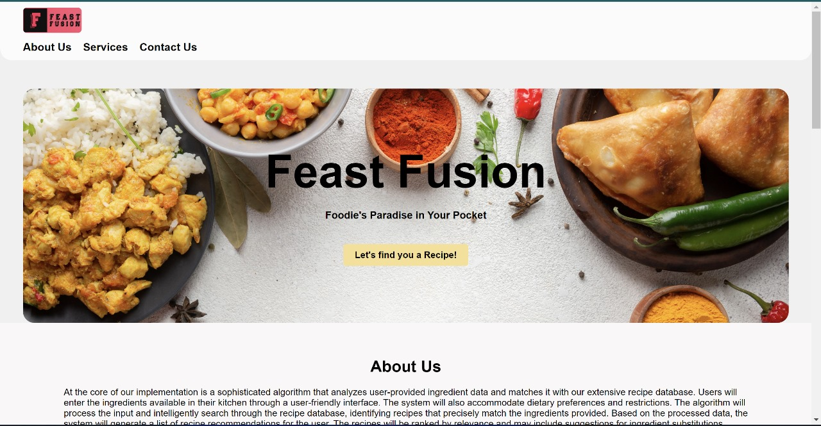
Result And Conclusion
Home Page

Slide 14
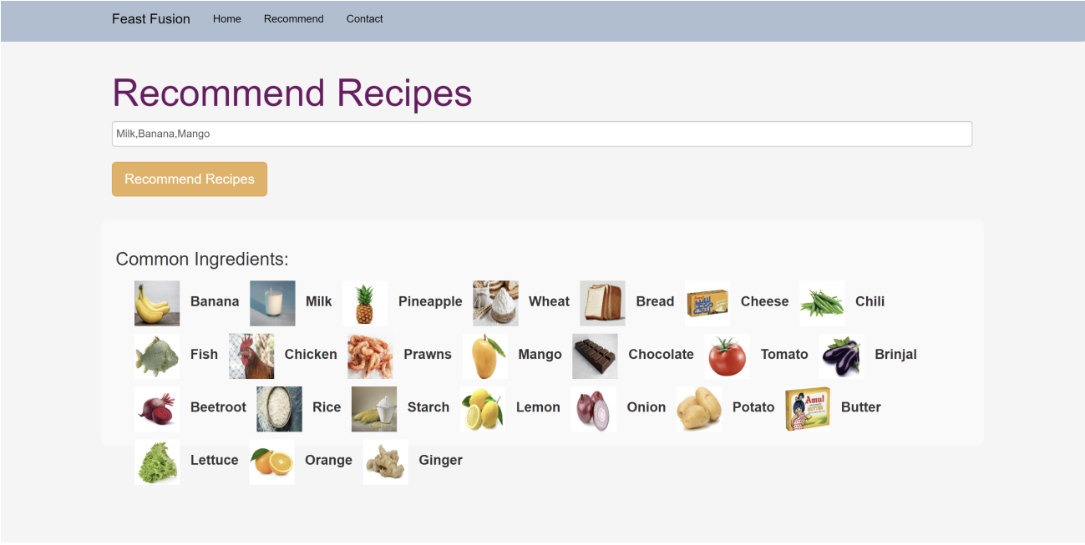
Recommendation Page

Slide 15
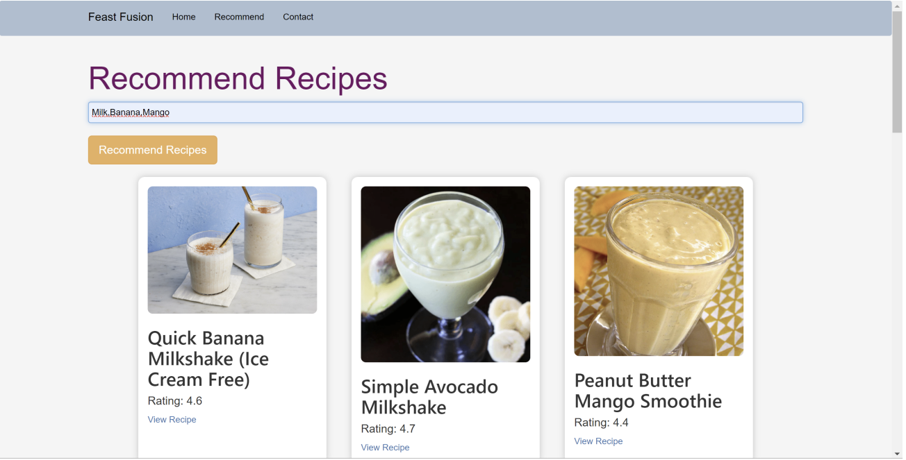
Result

Slide 16
References
Chhipa, S., Berwal, V., Hirapure, T., & Banerjee, S. (2022). Recipe Recommendation System Using TF-IDF. In ITM Web of Conferences (Vol. 44, p. 02006). EDP Sciences.
Yunanda, G., Nurjanah, D., & Meliana, S. (2022). Recommendation system from microsoft news data using TF-IDF and cosine similarity methods. Building of Informatics, Technology and Science (BITS), 4(1), 277-284.
Maruyama, T., Kawano, Y., & Yanai, K. (2012, November). Real-time mobile recipe recommendation system using food ingredient recognition. In Proceedings of the 2nd ACM international workshop on Interactive multimedia on mobile and portable devices (pp. 27-34).

Slide 17
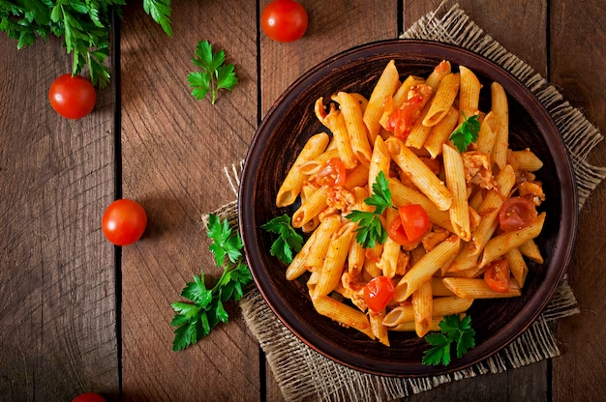
Feast Fusion
Thank You

